Slide 1
Data clustering
Lecturer: Assoc.Prof. Nguyễn Phương Thái
VNU University of Engineering and Technology
Slide: from Assoc.Prof. Phan Xuân Hiếu, Updated: September 05, 2023
data understanding
1 / 106
Notes:
Hiểu dữ liệu là bước quan trọng trong mô hình CRISP-DM (tổng 6 bước).

Slide 2
Expected lesson learning outcomes (LLOs)
LLO1. Trình bày được các phương pháp phân cụm cơ bản
LLO2. Giải thích được ưu nhược điểm của từng phương pháp phân cụm
LLO3. Áp dụng được các phương pháp này để khai phá và phân tích dữ liệu

Slide 3
Outline
Data clustering concepts
Data understanding before clustering
Hierarchical clustering
Partitioning clustering
Distribution–based clustering
Density–based clustering
Clustering validation and evaluation
References and Summary
data clustering

Slide 4
Outline
Data clustering concepts
Data understanding before clustering
Hierarchical clustering
Partitioning clustering
Distribution–based clustering
Density–based clustering
Clustering validation and evaluation
References and Summary
data clustering

Slide 5
What is data clustering?
Definition from Data Mining: Concepts and Techniques, J. Han et al. [1]
Cluster analysis or simply clustering is the process of partitioning a set of data objects (or observations) into subsets. Each subset is a cluster, such that objects in a cluster are similar to one another, yet dissimilar to objects in other clusters.
Definition from Mining of Massive Datasets, J. Leskovec et al. [3]
Clustering is the process of examining a collection of points, and grouping the points into clusters according to some distance measure. The goal is that points in the same cluster have a small distance from one another, while points in diflerent clusters are at a large distance from one another.
Definition from Wikipedia
Cluster analysis or clustering is the task of grouping a set of objects in such a way that objects in the same group (called a cluster) are more similar (in some sense) to each other than to those in other groups (clusters).
data clustering

Slide 6
Data clustering (cont’d)
Data clustering is also called unsupervised learning or unsupervised classification. Classification (supervised learning) is learning by examples whereas clustering is
learning by observation.
Two main types of clustering:
Hard clustering: each data point belongs to only one cluster.
Soft clustering: each data point can belong to one or more clusters.
Some characteristics:
The number of clusters of a dataset is normally unknown, or not really clear.
There are several clustering approaches, each has several clustering techniques. Different clustering approaches/techniques may give different results.
data clustering

Slide 7
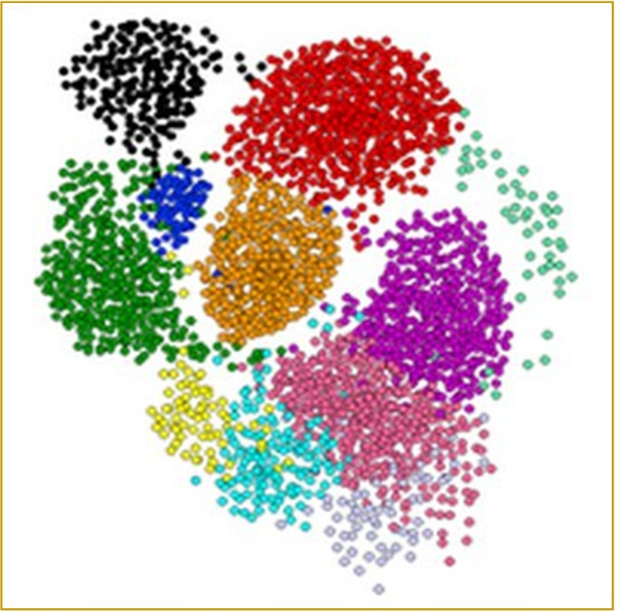
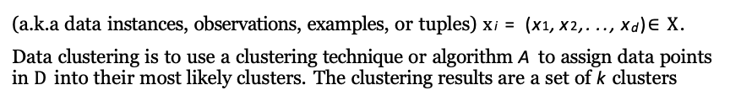
Data clustering problem
Let X = (X₁, X₂,. .., X_{d}) be a d–dimensional space, where each attribute/variable
X_{j} is numeric or categorical.
Let D = {x₁, x₂,. .., x_{n}} be a data sample or dataset consisting of n data points
(a.k.a data instances, observations, examples, or tuples) x_{i} = (x₁, x₂,. .., x_{d})$∈X$.
Data clustering is to use a clustering technique or algorithm A to assign data points in D into their most likely clusters. The clustering results are a set of k clusters
_{s}C = {C₁, C₂,. .., C_{k}}. Data points in the same cluster are similar to each other in ome sense and far from the data points in other clusters.
data clustering

Slide 8
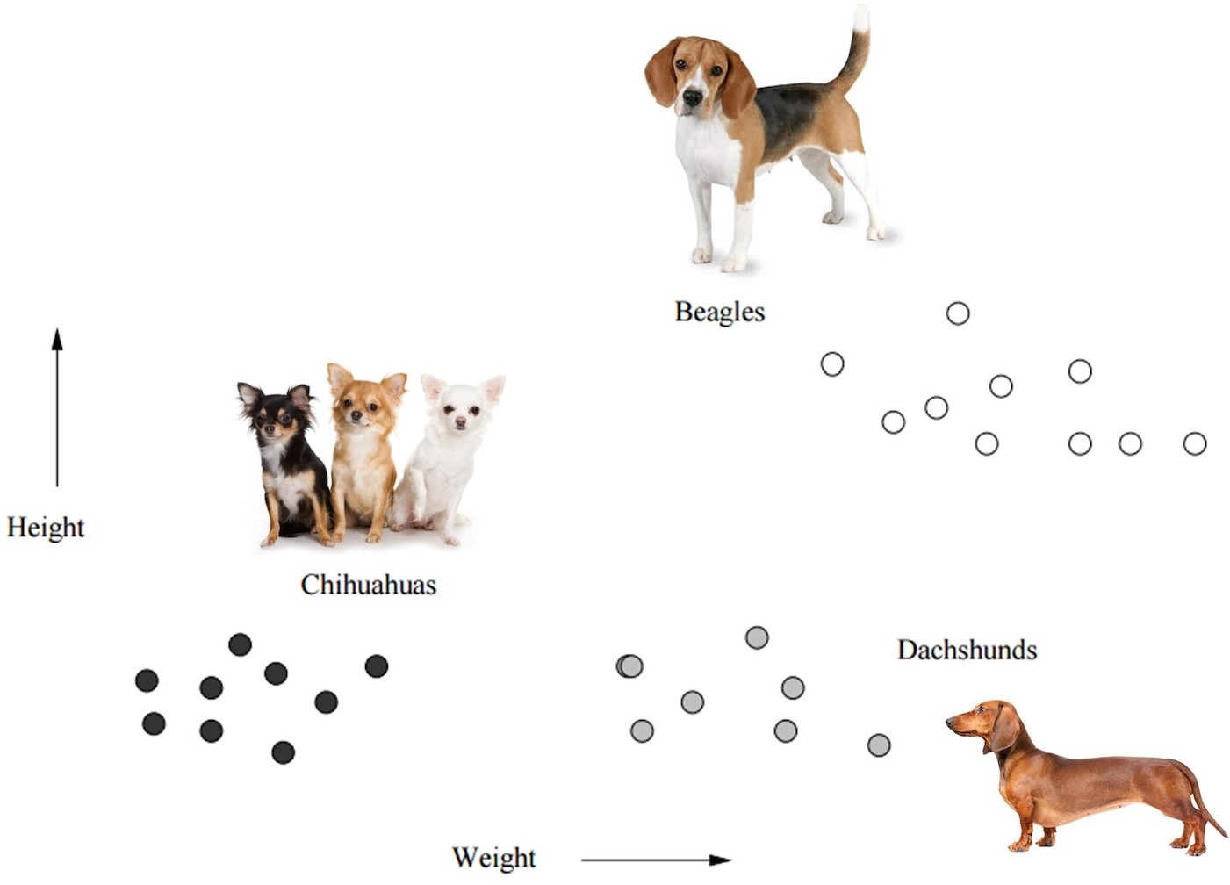
Example of data points in 2–dimensional space [3]
data clustering
Notes:
Trích tài liệu [3]

Slide 9
Observations about the clustering process and the results
The number of clusters k is specified in two ways: (1) k is an input parameter of the clustering algorithm, and (2) k can be determined automatically by the algorithm.
Normally, each data point belongs only one cluster (i.e., hard clustering).
If data points belong to more than one clusters (soft clustering), the membership
of x_{i} in a cluster C_{j} is characterized by a weight w_{ij} (e.g., in range [0, 1]).
Not all data points in D are assigned into clusters. There may be several data points
that are outliers or noise and they are excluded from the clusters.
The clustering results depend on clustering algorithms. Some algorithms is for hard clustering, some for soft clustering, some can deal with outliers and noise.
The cluster assignment for data points is performed automatically by clustering algorithms. Hence, clustering is useful in that it can lead to the discovery of previously unknown groups within the data.
data clustering

Slide 10
Requirements for data clustering
Scalability: clustering algorithms should be able to work with small, medium, and large datasets with a consistent performance.
Ability to deal with different types of attributes: clustering algorithms can work with different data types like binary, nominal (categorical), ordinal, numeric, or mixtures of those data types.
Discovery of clusters with arbitrary shape: algorithms based on such distance measures tend to find spherical clusters with similar size and density. However, a cluster could be of any shape. It is important to develop algorithms that can detect clusters of arbitrary shape.
Requirements for domain knowledge to determine input parameters: clustering should be as automatic as possible, voiding (biased) domain knowledge.
Ability to deal with noisy data: most real–world data sets contain outliers and/or missing, unknown, or erroneous data. Clustering algorithms can be sensitive to such noise and may produce poor–quality clusters. Therefore, we need clustering methods that are robust to noise.
data clustering

Slide 11
Requirements for data clustering (cont’d)
Incremental clustering and insensitivity to input order: in many applications, incremental updates (representing newer data) may arrive at any time. It is better if clustering algorithms can handle future data points in an incremental manner.
Capability of clustering high–dimensionality data: a data set can contain numerous dimensions or attributes. Finding clusters of data objects in a high- dimensional space is challenging, especially considering that such data can be very sparse and highly skewed.
Constraint–based clustering: real–world applications may need to perform clustering under various kinds of constraints, e.g., two particular data points cannot be in the same cluster or vice versa. Constraint integration into clustering algorithms is important in some application domains.
Interpretability and usability: users want clustering results to be interpretable, comprehensible, and usable. That is, clustering may need to be tied in with specific semantic interpretations and applications.
data clustering

Slide 12
Clustering approaches
Hierarchical methods: also called connectivity methods
Create a hierarchical decomposition of data, i.e., a tree of clusters (dendrogram). Hierarchical clustering can be agglomerative (bottom–up) or divisive (top–down). Use various similarity measures split or merge clusters.
This approach is hard clustering. The resulting clusters are in spherical shape.
Partitioning methods: also called centroid methods
Data points are partitioned into k exclusive clusters (k is an input parameter). Both centroid–based and distance–based.
Well–known techniques: k–means, k–medoids, k–medians, etc. This approach is also hard clustering.
Suitable for finding spherical–shaped clusters in small– to medium–size databases.
data clustering

Slide 13
Clustering approaches (cont’d)
Distribution–based methods: also called probabilistic models
Assuming data points are from a mixture of distributions, e.g., normal distributions.
Well–known methods: Gaussian mixture models (GMMs) with expectation maximization (EM) algorithm.
This is soft clustering. The clusters can overlap and have elliptical shapes.
For clusters in arbitrary shapes, distribution methods may fail because the distribution assumption is normally wrong.
Density–based methods:
Idea: continue to grow a cluster as long as the density (number of objects or data points) in the neighborhood exceeds some threshold.
This approach is suitable for clusters of arbitrary shapes. This approach can also deal with noise and outliers.
Most common algorithms are DBSCAN and OPTICS.
data clustering

Slide 14
Clustering approaches (cont’d)
Grid–based methods:
Quantize the object space into a finite number of cells that form a grid structure. All the clustering operations are performed on the grid structure.
Advantage: fast processing time, depending on the number of cells.
Efficient for spatial data clustering, can be combined with density–based method, etc.
Other approaches:
Graph–based methods:
finding clusters based on dense sub–graph mining like cliques or quasi–cliques. Subspace models:
clusters are modeled with both cluster members and relevant attributes.
Neural models:
the most well known unsupervised neural network is the self–organizing map.
data clustering

Slide 15
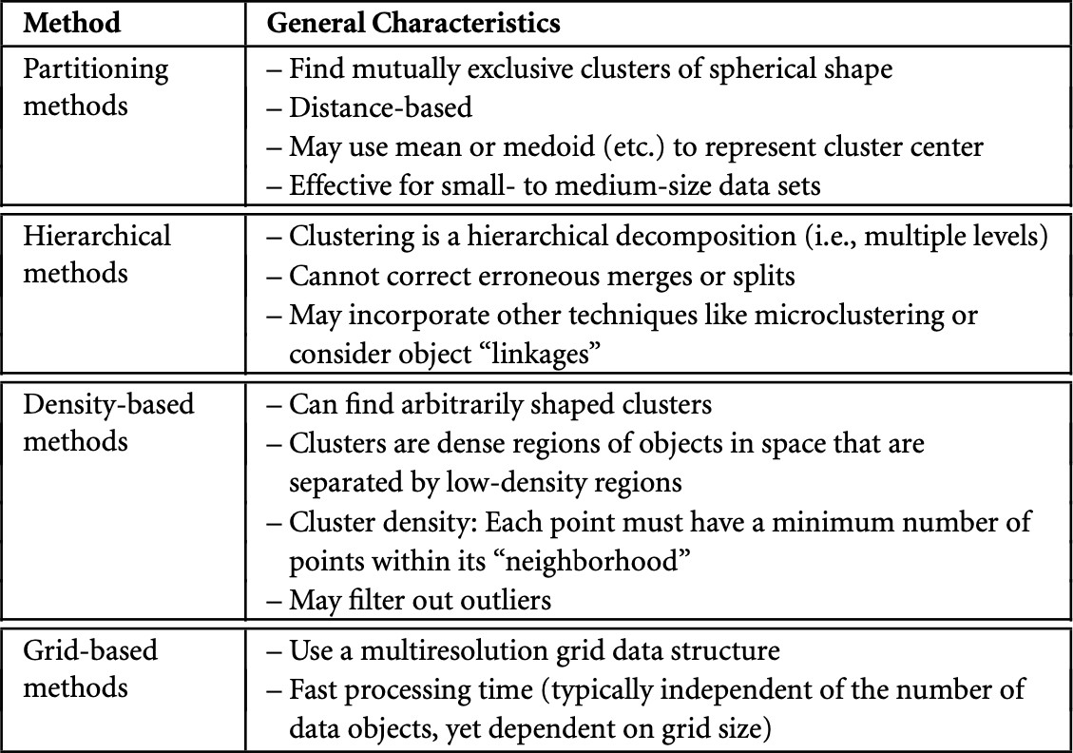
Clustering approaches (cont’d)
data clustering

Slide 16
Challenges in data clustering
Clustering with a high volume of data. Clustering in high–dimensional space.
Clustering with low–quality data (e.g., noisy and missing values).
Clustering with complex cluster structures (shape, density, overlapping, etc.).
Identifying right values for parameters that can reflects the nature of data (e.g., the right number of clusters, the right density, etc.)
Validation and assessment of clustering results.
data clustering

Slide 17
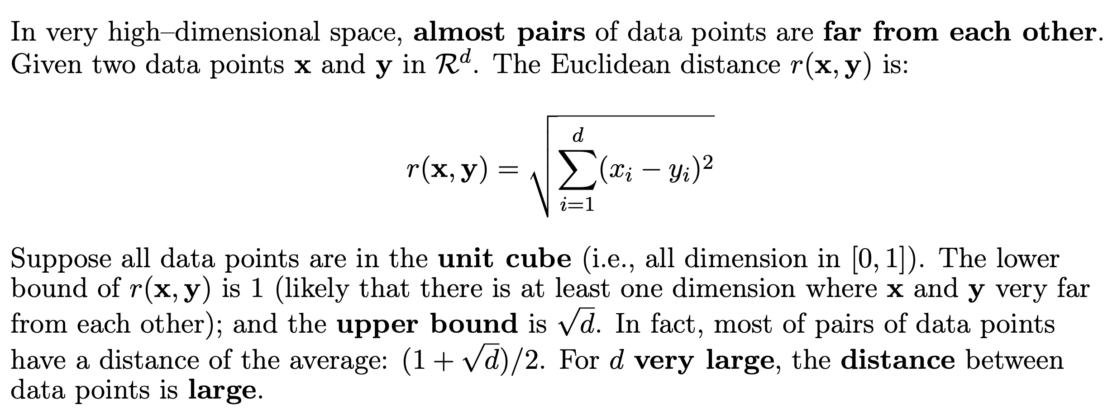
Clustering in high–dimensional space: the curse of dimensionality
data clustering

Slide 18
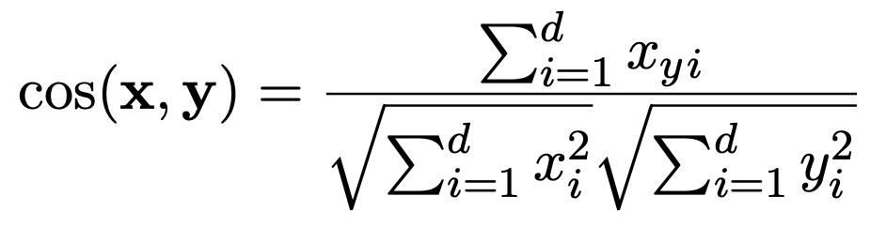
Clustering in high–dimensional space: the curse of dimensionality (2)
In a very high–dimensional space, two arbitrary vectors are nearly orthogonal. Consider the cosine similarity:
(2)
_{t}• When d is very large, the numerator is much smaller than the denominator, and he cosine between the two vectors is very close to zero.
If most of pairs of data points are orthogonal, it is very hard to perform clustering. The clustering results are normally very bad.
_{S}• One of the solution is dimensionality reduction with popular techniques like PCA, VD, or topic analysis or word embeddings (for text data).
data clustering

Slide 19
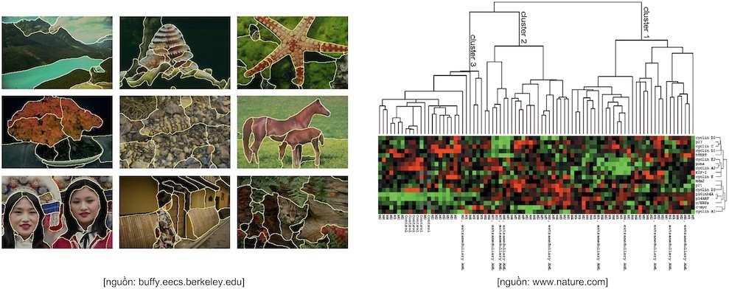
Applications of data clustering
data clustering

Slide 20
Applications of data clustering (cont’d)
Customer segmentation (telco, retail, marketing, finance and banking, etc.) Text clustering (news, email, customer care data, tag suggestion, etc.) Image processing, object segmentation, etc.
Biological data clustering (patients, health records, gene, etc.)
Finding similar users and sub–communities (graph, social networks, etc.) Buyer and product clustering (retail, recommender systems, etc.) Identifying fraudulent or criminal activities, etc.
Clustering can be a preprocessing step for further data analysis and mining.
Any data mining tasks that require to group data points into similar clusters. The applications can be found everywhere in data analysis and mining.
data clustering

Slide 21
Outline
Data clustering concepts
Data understanding before clustering
Hierarchical clustering
Partitioning clustering
Distribution–based clustering
Density–based clustering
Clustering validation and evaluation
References and Summary
data clustering

Slide 22
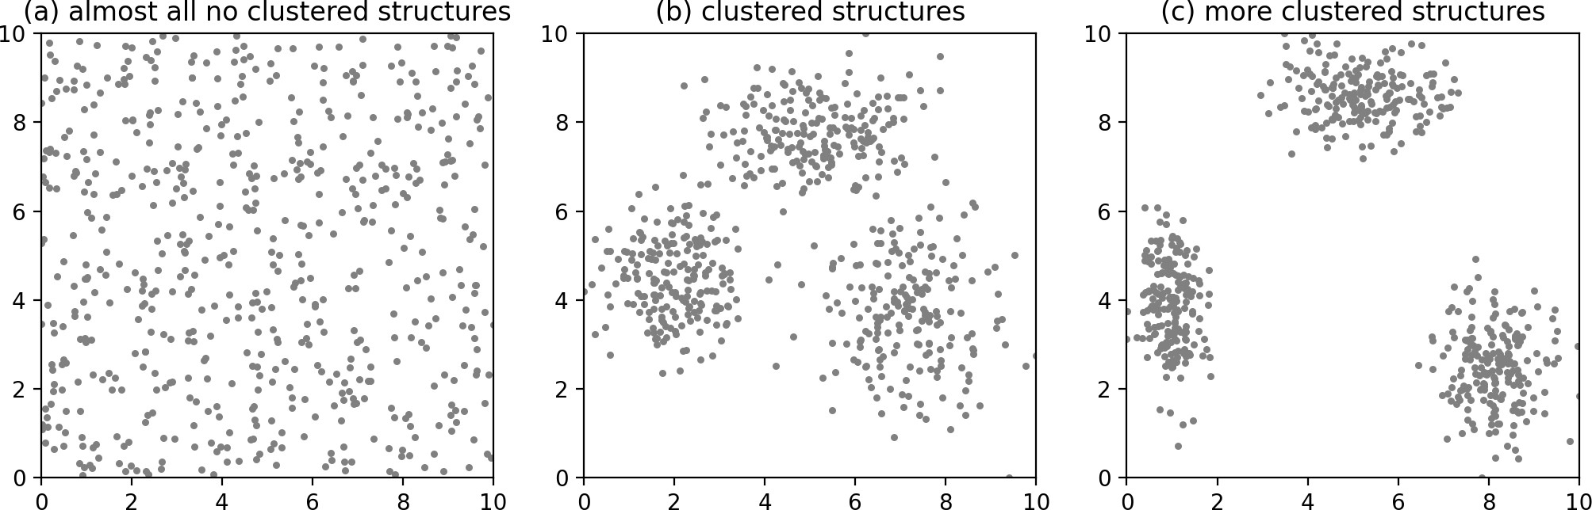
Understanding of data distribution
Do the data have cluster structures? Is the data clusterable (clusterability)? How to assess the data distribution mathematically and automatically?
data clustering

Slide 23
Clustering tendency identification methods
Spatial histogram (cell–based histogram) Cell–based entropy
Distance distribution Hopkins statistic
data clustering

Slide 24
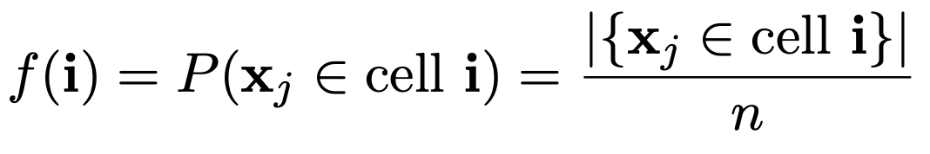
Validating cluster tendency with spatial histogram
A simple approach is to contrast the d–dimensional spatial histogram of the dataset
D with the histogram from samples generated randomly in the same data space.
Let X₁, X₂,. .., X_{d} denote the d dimensions. Given b, the number of bins for each dimension, we divide each dimension X_{j} into b equi–width bins, and simply count how many points lie in each of the b^{d} d–dimensional cells.
From these d–histograms, we can obtain the empirical joint probability mass function (EPMF) for the dataset D, which is an approximation of the unknown joint probability density function. The EPMF is given as
(3)
where i = (i₁, i₂,. .., i_{d}) denotes a cell index, with i_{j} denoting the bin index along dimension X_{j} ; n = |D|.
data clustering
Notes:
Tại sao lại gọi f là joint pmf? Nó là joint của các biến nào?
Tại sao mẫu số lại là n? -> n điểm thuộc tối đa n cell.

Slide 25
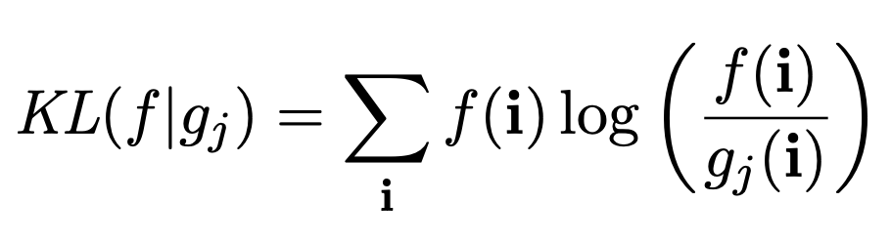
Validating cluster tendency with spatial histogram (cont’d)
Next, we generate t random samples, each comprising n points within the same
d–dimensional space as the input dataset D. That is, for each dimension X_{j} , we compute its range [min(X_{j} ), max(X_{j} )], and generate values uniformly at random with the given range. Let R_{j} denote the j–th such random sample.
Compute the corresponding EPMF g_{j} (i) for each R_{j} , 1 j t.
Compute how much the distribution f differs from g_{j} (for j = 1..t) using the Kullback–Leibler (KL) divergence from f to g_{j} , defined as:
(4)
The KL divergence is zero only when f and g_{j} are the same distributions. Using
these divergence values, we can compute how much the dataset D differs from a
random dataset.
Compute the expectation and the variance of KL(f |g_{j} ) (for j = 1..t).
data clustering

Slide 26
Example of spatial histogram [4]
The main limitation of this approach is that as dimensionality increases, the number of cells (b^{d}) increases exponentially, and with a fixed sample size n, most of the cells will be empty, or will have only one point, making it hard to estimate the divergence. The method is also sensitive to the choice of parameter b.
The example in the next slide shows the empirical joint probability mass function for the Iris principal components dataset that has n = 150 points in d = 2 dimensions.
It also shows the EPMF for one of the datasets generated uniformly at random in the same data space. Both EPMFs were computed using b = 5 bins in each dimension, for a total of 25 spatial cells.
With t = 500, and computed the KL divergence from f to g_{j} for each 1 j t
(using logarithm with base 2).
The mean KL value was µ_{KL} = 1.17, with a standard deviation of σ_{KL} = 0.18, indicating that the Iris data is indeed far from the randomly generated data, and thus is clusterable.
data clustering

Slide 27
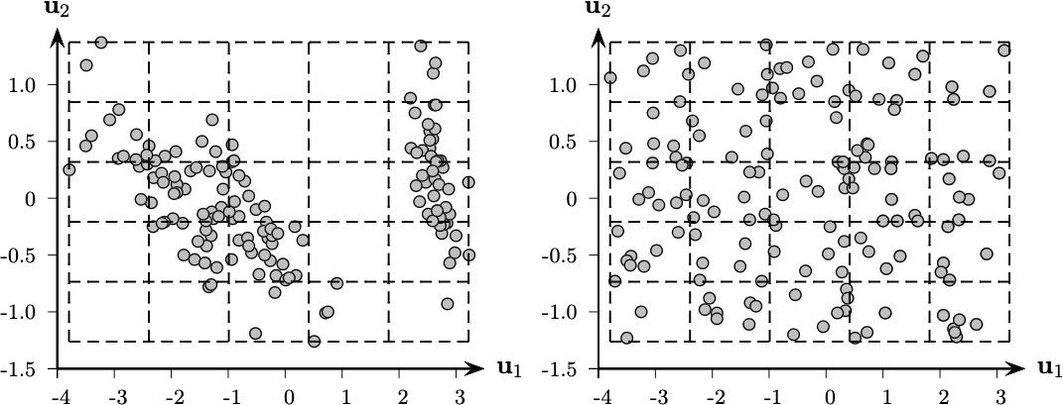
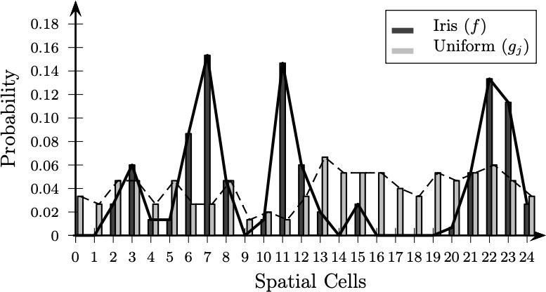
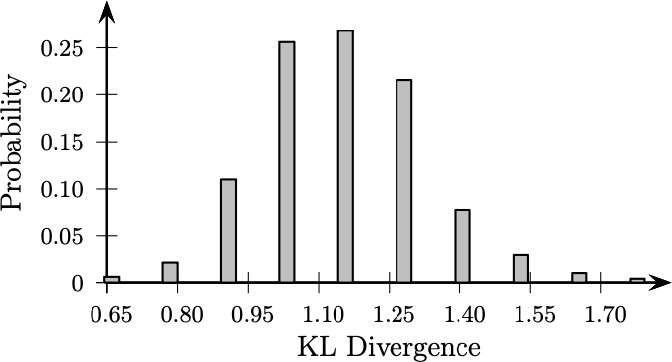
Example of spatial histogram [4] (cont’d)
data clustering

Slide 28
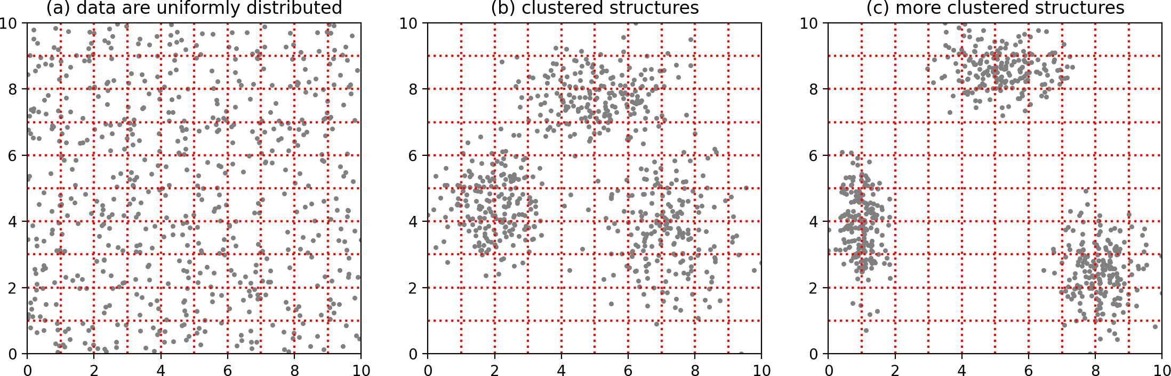
Validating cluster tendency with cell–based entropy
The data space is divided into a grid of k$×$k cells. For instance, k = 10, and then
the total number of cells is m = 100 cells.
Counting the number of data points in each cells for three cases (a), (b), and (c).
data clustering

Slide 29
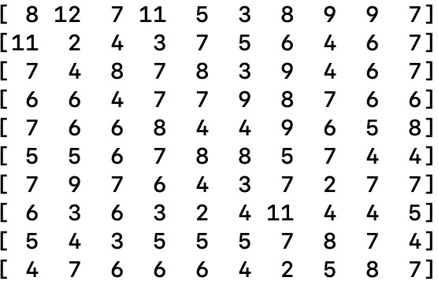
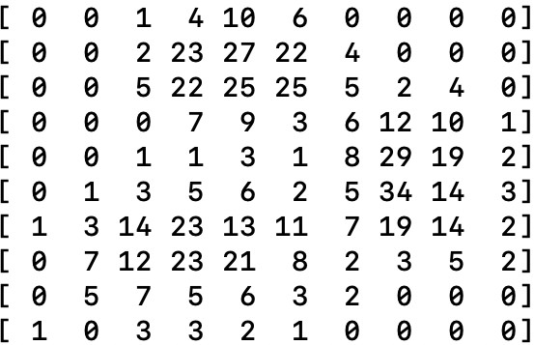
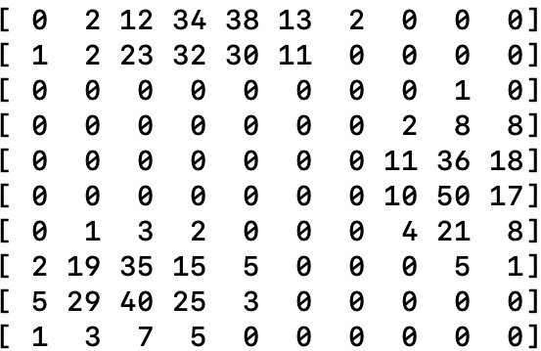
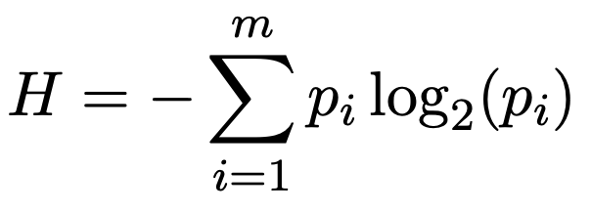
Validating cluster tendency with cell–based entropy (cont’d)
Calculate the entropy of the point distribution over cells, H:
(5)
where p_{i} = c_{i}/n with c_{i} is the number of data points in the i^{th} cell, and n is the total number of data points in all cells.
With m = 100 cells, the maximum entropy value is log₂ m = log₂ 100 = 6.6439. The
entropy can be normalized to [0, 1] by using H/ log₂ m.
data clustering
Notes:
Giải thích tại sao lại chia cho logm (định lý về giá trị cực đại của entropy).

Slide 30
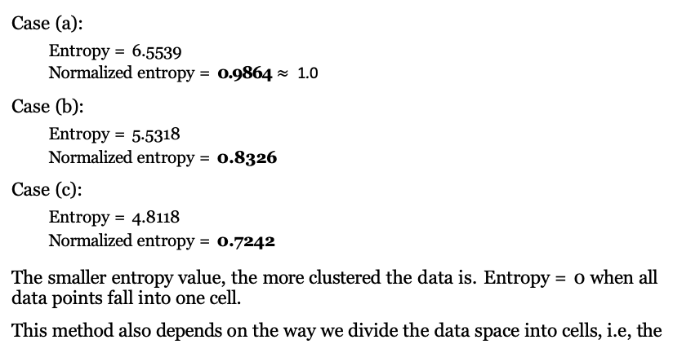
Validating cluster tendency with cell–based entropy (cont’d)
Case (a):
Entropy = 6.5539
Normalized entropy = 0.9864 $≈$ 1.0
Case (b):
Entropy = 5.5318
Normalized entropy = 0.8326
Case (c):
Entropy = 4.8118
Normalized entropy = 0.7242
The smaller entropy value, the more clustered the data is. Entropy = 0 when all data points fall into one cell.
This method also depends on the way we divide the data space into cells, i.e, the
total number of cells.
data analysis and mining course @ Xuan–Hieu Phan
data clustering

Slide 31
Validating cluster tendency with distance distribution
Instead of trying to estimate the density, another approach to determine clusterability is to compare the pair–wise point distances from D, with those from the randomly generated samples R_{i} from the null distribution (i.e., uniformly distributed data).
First, compute the pair–wise distance values for every pair of points in D to form a
proximity matrix W = {w_{pq} }_{p,q=1..n} using some distance measure.
Then create the EPMF from the proximity matrix W by binning the distances into
b bins:
_{∈ D,p > q) =} |{w_{pq} ∈ bin i}|
f (i) = P (w_{pq} ∈ bin i | x_{p}, x_{q}
(6)
n(n — 1)/2
Likewise, for each of the (uniformly distributed) samples R_{j} (j = 1..t), we can determine the EPMF for the pair–wise distances, denoted g_{j} .
Finally, compute the KL divergences between f and g_{j} (for j = 1..t). And compute the expectation and the variance of the KL divergence values.
data clustering
30 / 135

Slide 32
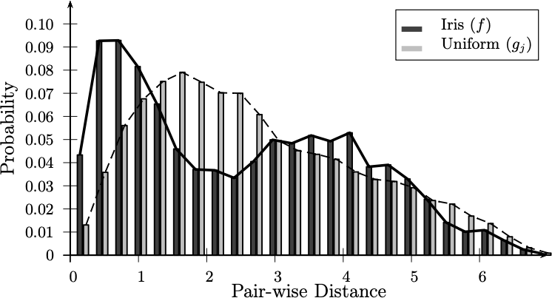
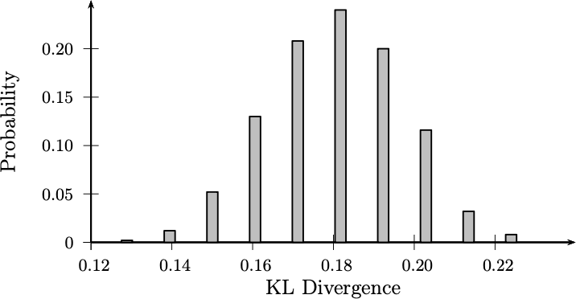
Example of distance distribution [4]
Number of bins b = 25; t = 500 samples.
KL divergence computed using logarithm with base 2. The mean divergence is
µ_{KL} = 0.18, with standard deviation σ_{KL} = 0.017.
Even though the Iris dataset has a good clustering tendency, the KL divergence is not very large. We conclude that, at least for the Iris dataset, the distance distribution is not as discriminative as the spatial histogram approach for clusterability analysis.
data clustering

Slide 33
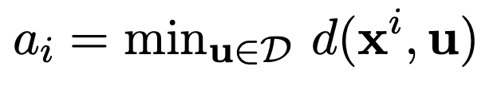
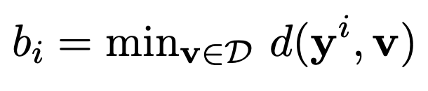
Validating cluster tendency with Hopkins statistic
Let D = {x₁, x₂,. .., x_{n}} be a set of n data instances in R^{m}.
Randomly choose h (< n) data instances {x¹, x²,. .., x^{h}} from D. For each data
instance x^{i}, finding the distance to its closest instance in D.
(7)
Randomly generate h pseudo data instances {y¹, y²,. .., y^{h}} in R^{m} according to uniform distribution in all m dimensions and the value range for each dimension is the same as data in D. For each data instance y^{i}, finding the distance to its closest instance in D.
(8)
data clustering
Notes:
Hopkins statistic cũng là một phương pháp thống kê dùng để đánh giá xu hướng phân cụm (cluster tendency) của một tập dữ liệu. Nó giúp xác định liệu dữ liệu có khả năng hình thành các cụm hay không, trước khi áp dụng các thuật toán phân cụm như K-means hoặc K-medoids.
Ý tưởng chính của Hopkins statistic: Mục tiêu chính là kiểm tra xem liệu dữ liệu có được phân bố ngẫu nhiên trong không gian hay có xu hướng tập trung thành các cụm. Chỉ số này so sánh sự phân bố của các điểm trong tập dữ liệu với sự phân bố ngẫu nhiên của các điểm giả định.
Các bước thực hiện:
+ Chọn ngẫu nhiên một số điểm từ dữ liệu thật: Giả sử tập dữ liệu có n điểm, ta chọn ngẫu nhiên một số h điểm từ tập này.
+ Sinh ngẫu nhiên các điểm giả định: Với mỗi điểm đã chọn từ dữ liệu thật, sinh ra một điểm giả định (random point) trong không gian dữ liệu bằng cách chọn ngẫu nhiên từ không gian dữ liệu đã cho (khoảng bao phủ của dữ liệu).
+ Tính khoảng cách gần nhất: Đối với mỗi điểm trong tập dữ liệu đã chọn, tính khoảng cách của nó tới điểm gần nhất trong toàn bộ tập dữ liệu thật (không tính chính nó). Tương tự, tính khoảng cách từ các điểm giả định đến điểm gần nhất trong tập dữ liệu thật.

Slide 34
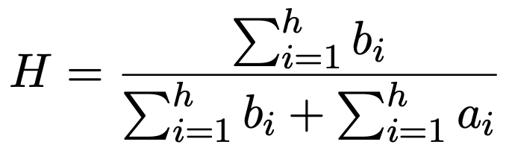
Validating cluster tendency with Hopkins statistic (cont’d)
Hopkins statistic, H, is computed as:
(9)
If data in D is uniformly or near–uniformly distributed, H will be near 0.5.
If H is close to 1.0, D has cluster structures, i.e., far from the uniform distribution.
data clustering
Notes:
Các bước thực hiện (tiếp):
+ Tính Hopkins statistic: Chỉ số Hopkins được tính dựa trên tỷ lệ giữa tổng các khoảng cách của điểm giả định so với tổng các khoảng cách của điểm thật.

Slide 35
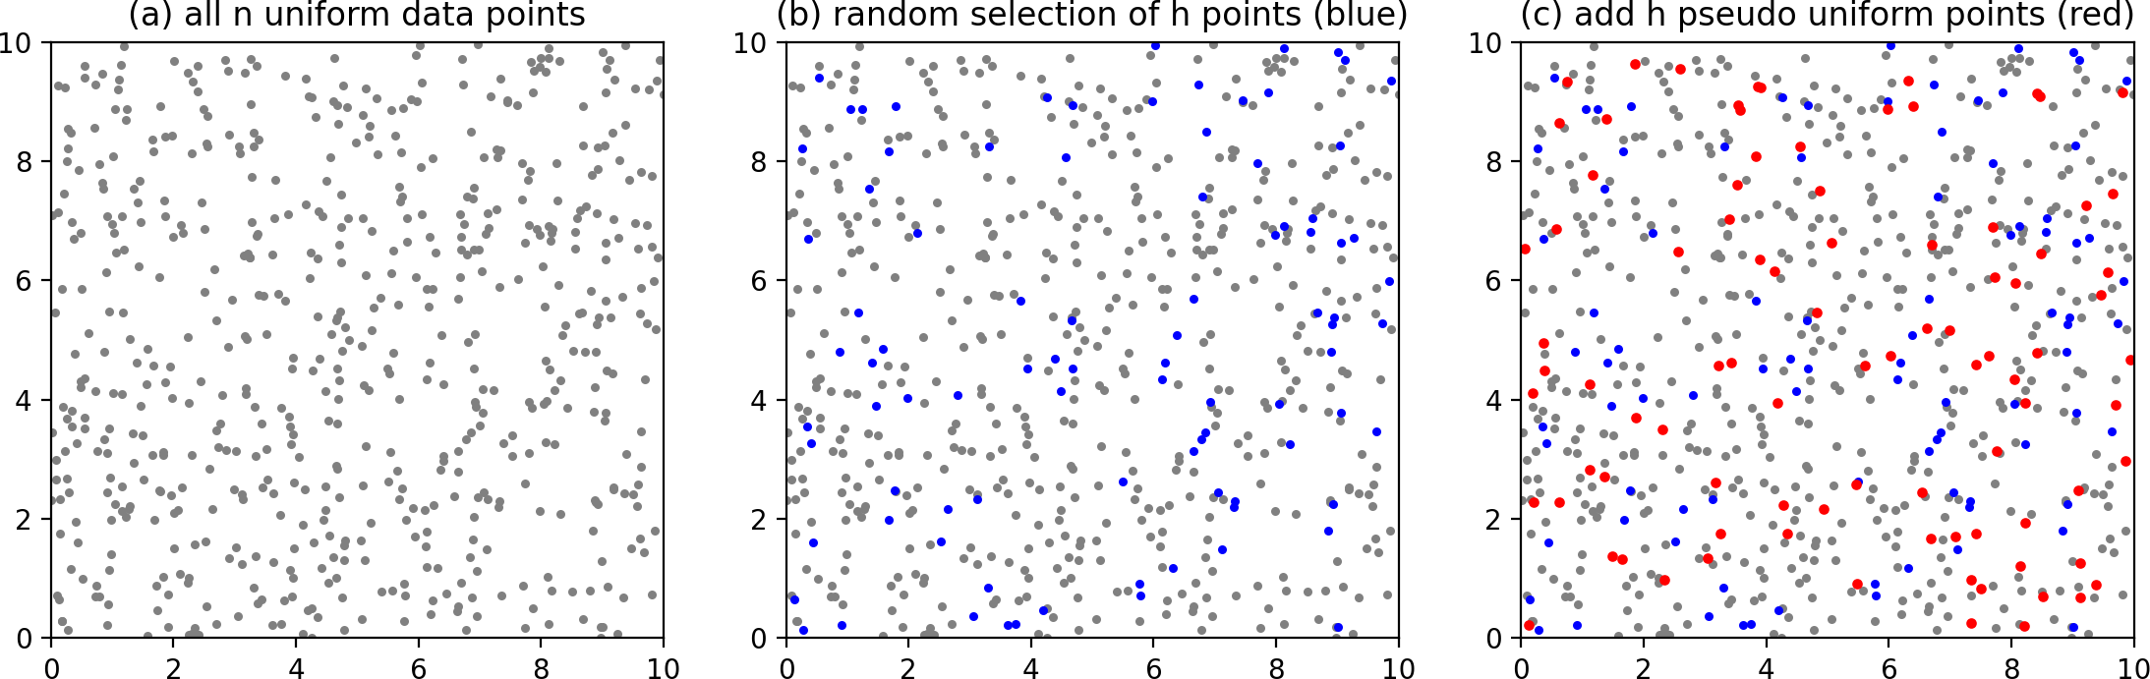
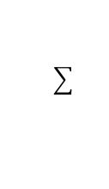
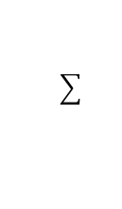
Example of Hopkins statistic with uniformly distributed data
D consists of n = 600 uniformly distributed data points, h = 90.
h i=1
a = 18.4981 and
h i=1
b_{i} = 19.9432.
i
Hopkins statistic: H = 19.9432/(19.9432 + 18.4981) = 0.5188 $≈$0.5
data clustering

Slide 36
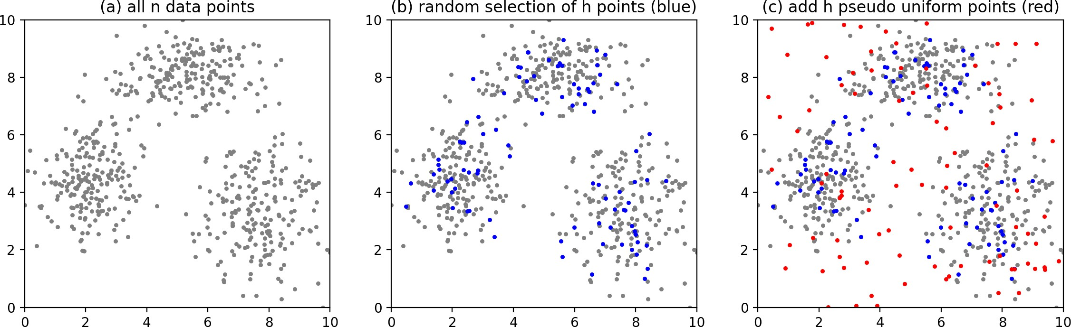
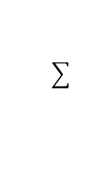
Example of Hopkins statistic with normal distribution clusters
D consists of n = 600 uniformly distributed data points, h = 90.
h i=1
a = 13.2464 and
h i=1
b_{i} = 45.1340.
i
Hopkins statistic: H = 45.1340/(45.1340 + 13.2464) = 0.7731
data clustering
35 / 135

Slide 37
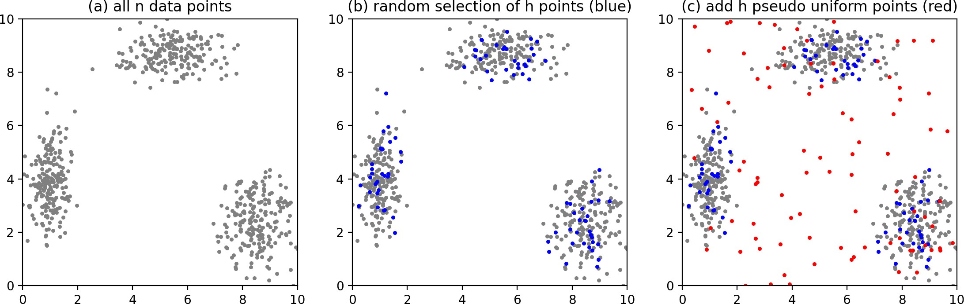
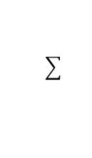
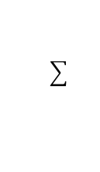
Example of Hopkins statistic with normal distribution data (cont’d)
D consists of n = 600 uniformly distributed data points, h = 90.
h i=1
a = 9.3838 and
h i=1
b_{i} = 81.5614.
i
Hopkins statistic: H = 81.5614/(81.5614 + 9.3838) = 0.8968
data clustering

Slide 38
Outline
Data clustering concepts
Data understanding before clustering
Hierarchical clustering
Partitioning clustering
Distribution–based clustering
Density–based clustering
Clustering validation and evaluation
References and Summary
data clustering

Slide 39
Hierarchical clustering
Given dataset D consisting of n data points in a d–dimensional space, the goal of hierarchical clustering is to create a sequence of nested partitions, which can be conveniently visualized via a tree or hierarchy of clusters, also called the cluster dendrogram.
The clusters in the hierarchy range from the fine–grained to the coarse–grained: the lowest level of the tree (the leaves) consists of each point in its own cluster, whereas the highest level (the root ) consists of all points in one cluster.
At some intermediate level, we may find meaningful clusters. If the user supplies k, the desired number of clusters, we can choose the level at which there are k clusters.
There are two main algorithmic approaches to mine hierarchical clusters:
agglomerative (bottom–up) and divisive (top–down).
data clustering

Slide 40
Hierarchical clustering (cont’d)
Given D = {x₁, x₂,. .., x_{n}}, where x_{i} ∈ R^{d}, a clustering C = {C₁, C2, .. ., C_{k}} is a partition of D, i.e., each cluster is a set of data points C_{i} ⊆ D, such that the clusters are pairwise disjoint C_{i} ∩ C_{j} = Ø (for all i /= j), and ∪C_{i} = D.
A clustering A = {A₁, A₂,. .., A_{r}} is said to be nested in another clustering
_{cl}B = {B₁, B₂,. .., B_{s}} if and only if r > s, and for each cluster A_{i} ∈ A, there exists a uster B_{j} ∈ B, such that A_{i} ⊆ B_{j} .
Hierarchical clustering yields a sequence of m nested partitions C₁, C₂, .. . , C_{m}, ranging from the trivial clustering C₁ = {{x₁}, {x₂},. .., {x_{n}}} where each point is
in a separate cluster, to the other trivial clustering C_{m} = {{x₁, x₂,. .., x_{n}}}, where
all points are in one cluster.
In general, the clustering C_{t—1} is nested in the clustering C_{t}.
The cluster dendrogram is a rooted binary tree that captures this nesting
structure, with edges between cluster C_{i} ∈ C_{t—1} and cluster C_{j} ∈ C_{t} if C_{i} is nested in
C_{j} , i.e., if C_{i} c C_{j} .
data clustering

Slide 41
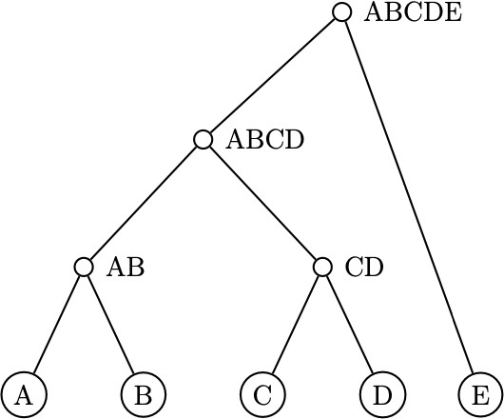
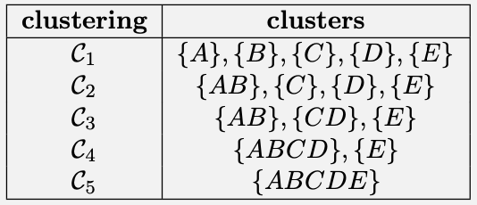
The dendrogram and nested clustering solutions [4]
The left figure is the dendrogram.
The right table is the five levels of nested clustering solutions, corresponding to the dendrogram on the left.
data clustering

Slide 42
Agglomerative hierarchical clustering
In agglomerative hierarchical clustering, we begin with each of the n data points in a separate cluster.
We repeatedly merge the two closest clusters until all points are members of the same cluster, as shown in the pseudo code (next slide).
Given a set of clusters C = {C₁, C₂,. .., C_{m}}, we find the closest pair of clusters C_{i}
and C_{j} and merge them into a new cluster C_{ij} = C_{i} ∪ C_{j} .
Next, we update the set of clusters by removing C_{i} and C_{j} and add C_{ij} , as follows
C = C \ {{C_{i}} ∪ {C_{j} }} ∪ {C_{ij} }.
This process is repeated until C contains only one cluster. If specified, we can stop the merging process when there are exactly k clusters remaining.
data clustering

Slide 43
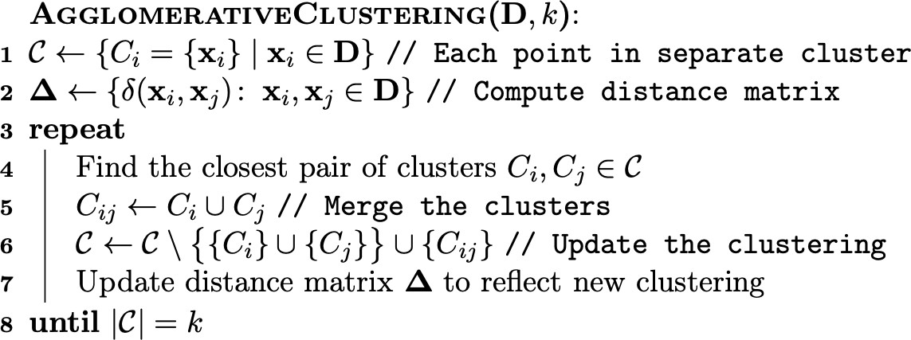
Agglomerative hierarchical clustering: the pseudo code [4]
data clustering

Slide 44
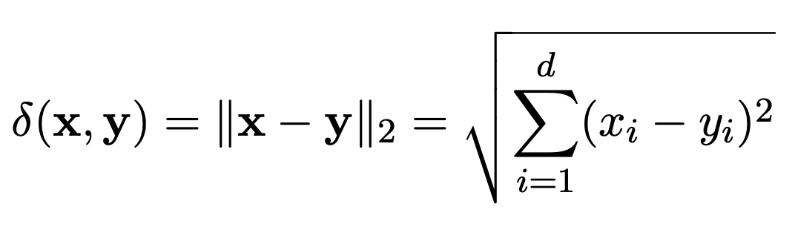
Distance between clusters: different ways to merge clusters
The main step in the algorithm is to determine the closest pair of clusters.
The cluster–cluster distances are ultimately based on the distance between two points, which is typically computed using the Euclidean distance or L₂–norm, defined as
v
(10)
There are several ways to measure the proximity between two clusters: single link, complete link, average link, centroid link, radius, and diameter.
data clustering

Slide 45
Distance between clusters: different ways to merge clusters (cont’d)
Single link:
Given two clusters C_{i} and C_{j} , the distance between them, denoted δ(C_{i}, C_{j} ) is defined as the minimum distance between a point in C_{i} and a point in C_{j} :
δ(C_{i}, C_{j} ) = min{δ(x, y) | x ∈ C_{i}, y ∈ C_{j} }
Merging any two clusters having the smallest single link distance at each iteration.
Complete link:
The distance between two clusters is defined as the maximum distance between a point in C_{i} and a point in C_{j} :
(11)
δ(C_{i}, C_{j} ) = max{δ(x, y) | x ∈ C_{i}, y ∈ C_{j} } (12) Merging any two clusters having the smallest complete link distance at each iteration.
data clustering

Slide 46
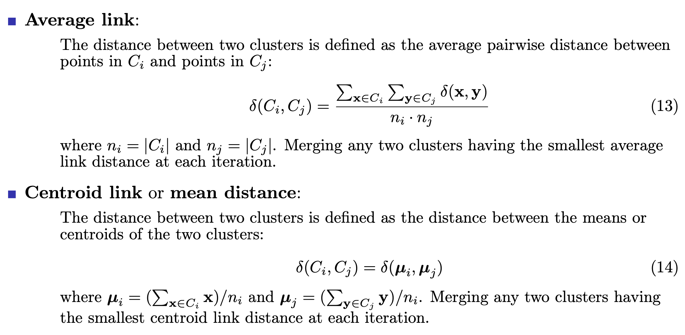
Distance between clusters: different ways to merge clusters (cont’d)
data clustering

Slide 47
Distance between clusters: different ways to merge clusters (cont’d)
Radius:
Radius of a cluster is the distance from its centroid (mean) µ to the furthest point in the cluster:
r(C) = max{δ(µ_{C}, x) | x ∈ C)} (15)
Merging any two clusters that form a new cluster (if being merged) having smallest radius at each iteration.
Diameter:
Diameter of a cluster is the distance between two furthest points in the cluster:
d(C) = max{δ(x, y) | x, y ∈ C)} (16)
Merging any two clusters that form a new cluster (if being merged) having smallest diameter at each iteration.
data clustering

Slide 48
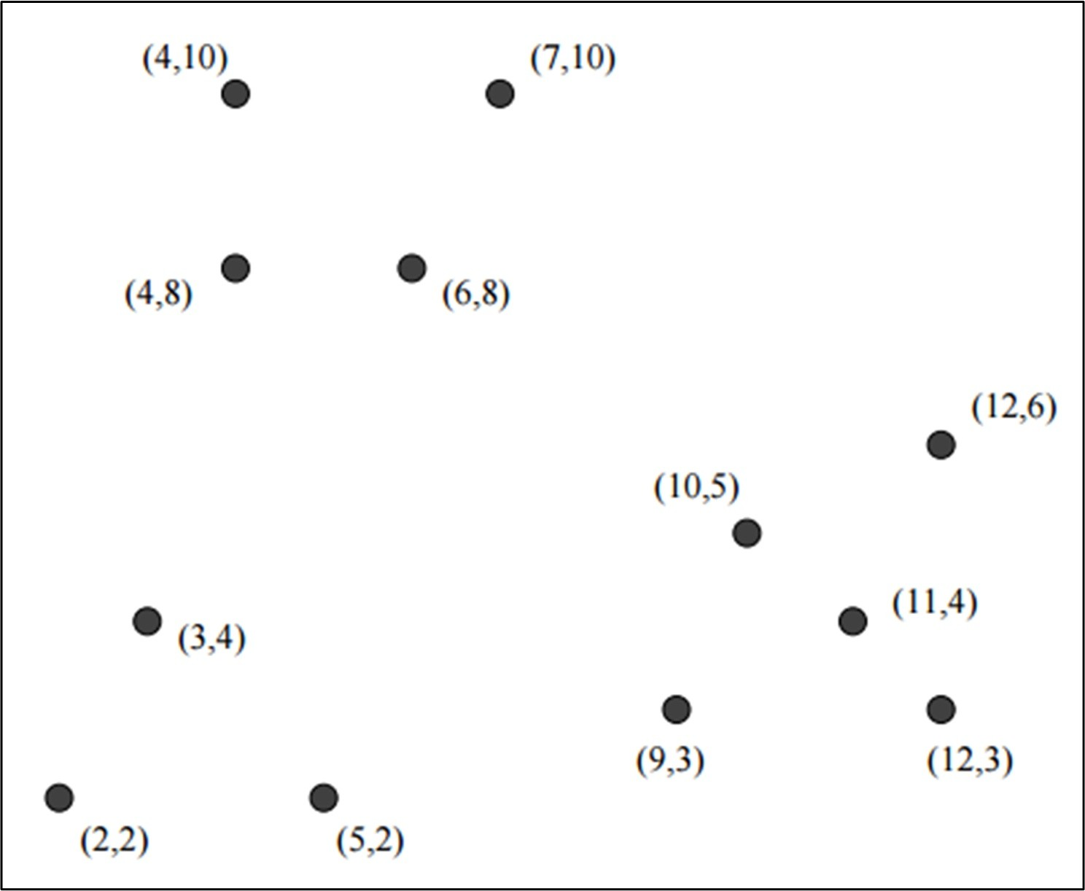
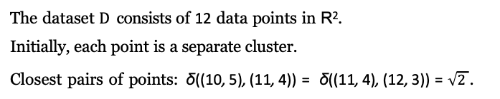
Example of agglomerative hierarchical clustering
The dataset D consists of 12 data points in R². Initially, each point is a separate cluster.
Closest pairs of points: δ((10, 5), (11, 4)) = δ((11, 4), (12, 3)) =$\sqrt{2}$.
data clustering

Slide 49
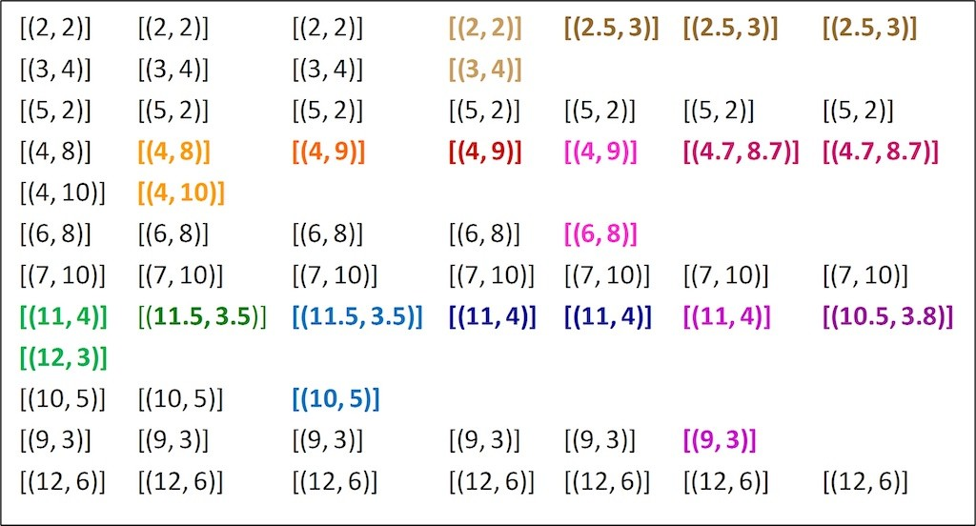
Example of agglomerative hierarchical clustering: cluster merging
data clustering

Slide 50
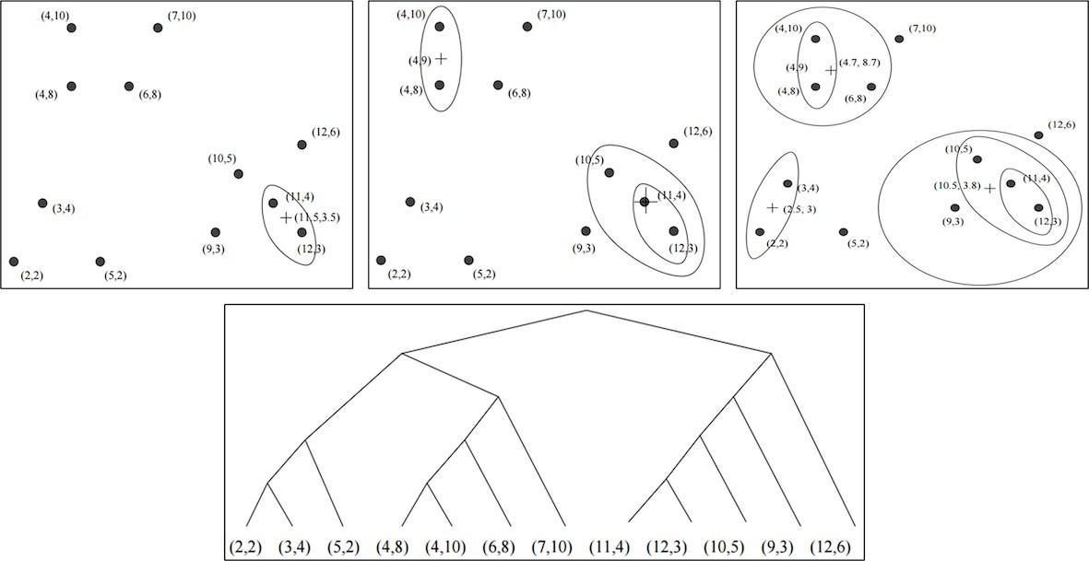
Example of agglomerative hierarchical clustering: the results
data clustering

Slide 51
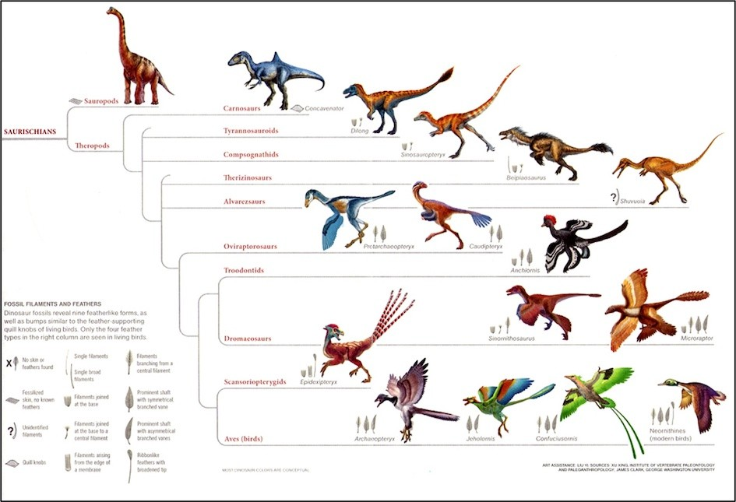
When should we stop merging?
When we have a prior knowledge about the number of potential clusters in the data.
When the merging starts produce low–quality clusters (e.g., the average distance from points in a cluster to its mean is larger than a given threshold).
When the algorithm produces the whole dendrogram, e.g., an evolutionary tree.
data clustering

Slide 52
Agglomerative clustering: computational complexity
Compute the distance of each cluster to all other clusters, and at each step the number of clusters decreases by one. Initially it takes O(n²) time to create the pairwise distance matrix, unless it is specified as an input to the algorithm.
At each merge step, the distances from the merged cluster to the other clusters have to be recomputed, whereas the distances between the other clusters remain the same. This means that in step t, we compute O(n — t) distances.
The other main operation is to find the closest pair in the distance matrix. For this we can keep the n² distances in a heap data structure, which allows us to find the minimum distance in O(1) time; creating the heap takes O(n²) time.
Deleting/updating distances from the merged cluster takes O(log n) time for each operation, for a total time across all merge steps of O(n² log n).
Thus, the computational complexity of hierarchical clustering is O(n² log n).
data clustering

Slide 53
Outline
Data clustering concepts
Data understanding before clustering
Hierarchical clustering
Partitioning clustering
Distribution–based clustering
Density–based clustering
Clustering validation and evaluation
References and Summary
data clustering

Slide 54
Partitioning clustering methods
The simplest and most fundamental version of cluster analysis is partitioning, which organizes the objects of a set into several exclusive groups or clusters.
We can assume that the number of clusters is given as background knowledge. This parameter is the starting point for partitioning methods.
Formally, given a data set, D, of n objects, and k, the number of clusters to form, a partitioning algorithm organizes the objects into k partitions (k n), where each partition represents a cluster.
The clusters are formed to optimize an objective partitioning criterion, such as a dissimilarity function based on distance, so that the objects within a cluster are “similar” to one another and “dissimilar” to objects in other clusters in terms of the data set attributes.
Most popular partitioning algorithms are k–means, k–mediods, and k–medians. These methods use a centroid point to represent each cluster. Thus, they are also called representative or centroid methods.
data clustering

Slide 55
Data clustering problem revisited
Let X = (X₁, X₂,. .., X_{d}) be a d–dimensional space, where each attribute/variable
X_{j} is numeric or categorical.
Let D = {x₁, x₂,. .., x_{n}} be a data sample or dataset consisting of n data points
(a.k.a data instances, observations, examples, or tuples) x_{i} = (x₁, x₂,. .., x_{d}) ∈ X.
Data clustering is to use a clustering technique or algorithm A to assign data points in D into their most likely clusters. The clustering results are a set of k clusters
_{s}C = {C₁, C₂,. .., C_{k}}. Data points in the same cluster are similar to each other in ome sense and far from the data points in other clusters.
data clustering
54 / 135

Slide 56
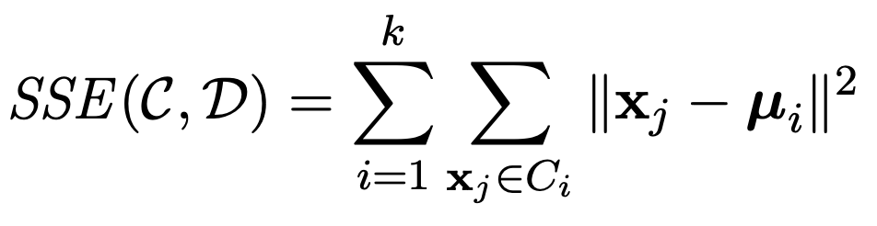
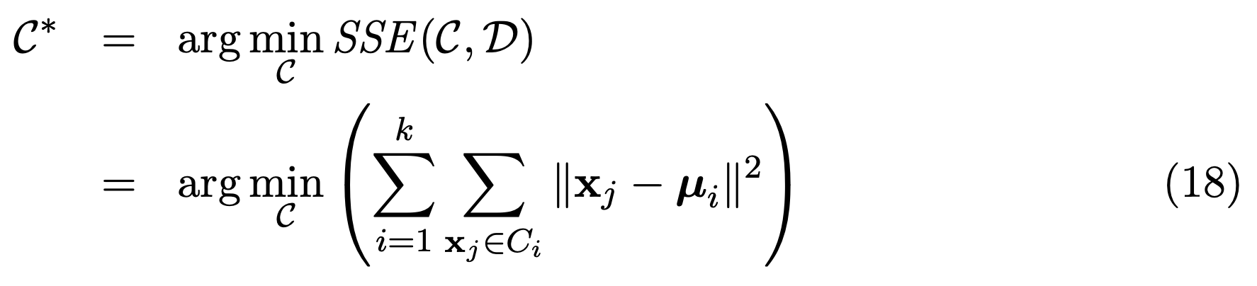
K–means algorithm
Let C = {C₁, C₂,. .., C_{k}} be a clustering solution, we need some scoring function that evaluates its quality or goodness on D. This sum of squared errors scoring function is defined as:
(17)
The goal is to find the clustering solution C* that minimizes the SSE score:
K–means algorithm employs a greedy iterative approach to find a clustering solution that minimizes the SSE objective. As such it can converge to a local optima instead of the globally optimum clustering.
data clustering

Slide 57
K–means algorithm (cont’d)
K–means initializes the cluster means by randomly generating k points in the data space. This is typically done by generating a value uniformly at random within the range for each dimension.
Each iteration of k–means consists of two steps:
Cluster assignment, and Centroid or mean update.
Given the k cluster means, in the cluster assignment step, each point x_{j} ∈ D is assigned to the closest mean, which induces a clustering, with each cluster C_{i} comprising points that are closer to µ_{i} than any other cluster mean. That is, each point x_{j} is assigned to cluster C_{j}* , where
J* = arg min x_{j} — µ_{i} ² (19)
i=1..k
data clustering

Slide 58
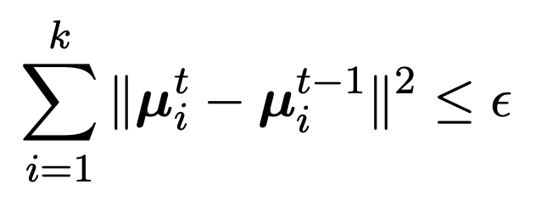

K–means algorithm (cont’d)
Given a set of clusters C_{i}, i = 1..k, in the centroid update step, new mean values are computed for each cluster from the points in C_{i}.
The cluster assignment and centroid update steps are carried out iteratively until we reach a fixed point or local minima.
Practically speaking, one can assume that k–means has converged if the centroids do not change from one iteration to the next. For instance, we can stop if
(20)
where $ε$ > 0 is the convergence threshold, and t denotes the current iteration.
data clustering

Slide 59
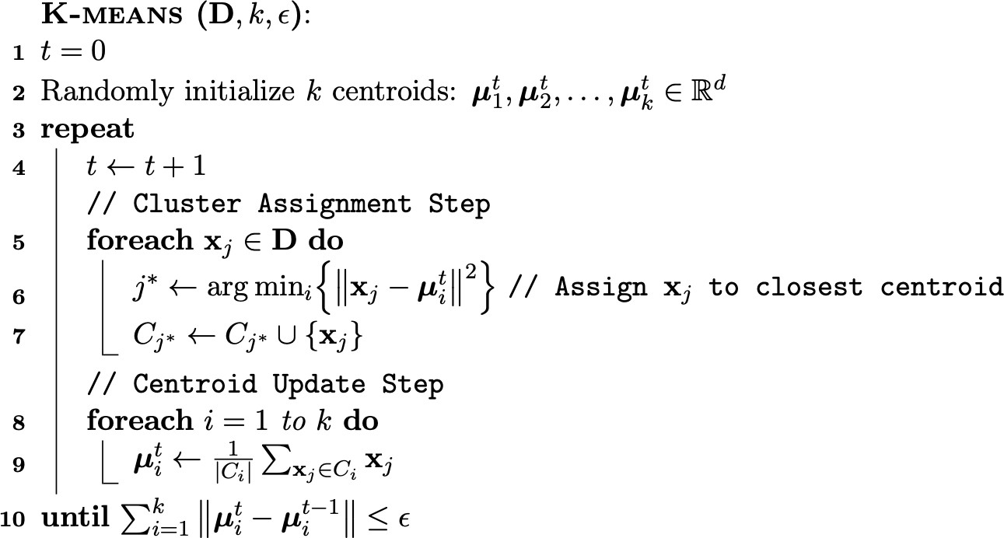
K–means algorithm: the pseudo code [4]
data clustering

Slide 60
K–means algorithm: computational complexity
The cluster assignment step take O(nkd) time, since for each of the n points we have to compute its distance to each of the k clusters, which takes d operations in d dimensions.
The centroid re–computation step takes O(nd) time, since we have to add at total of
n d–dimensional points.
Assuming that there are t iterations, the total time for k–means is O(tnkd).
In terms of the I/O cost it requires O(t) full database scans, since we have to read the entire database in each iteration.
data clustering

Slide 61
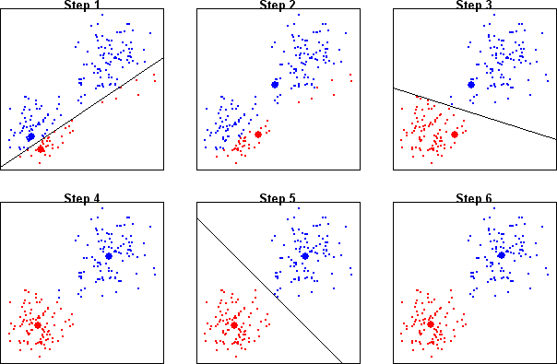
K–means algorithm: example 1
Clustering with k–means [source: sherrytowers.com/2013/10/24/k-means-clustering]
data clustering

Slide 62
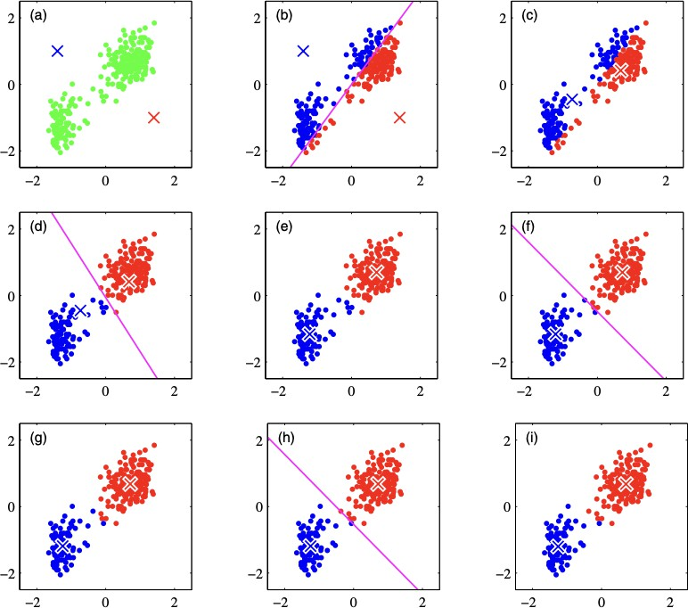
K–means algorithm: example 2
Clustering with k–means [from Pattern Recognition and Machine Learning by C.M. Bishop]
data clustering
61 / 135

Slide 63
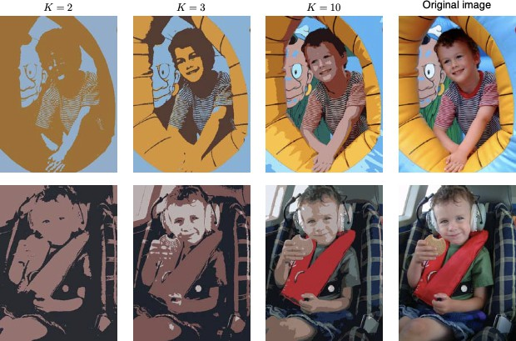
K–means algorithm: example 3 (image segmentation)
Image segmentation with k–means [from Pattern Recognition and Machine Learning by C.M. Bishop]
data clustering

Slide 64
Initialization for k mean vectors µ_{i}
The initial means should lay in different clusters. There are two approaches:
Pick points that are as far away from one another as possible.
Cluster a (small) sample of the data, perhaps hierarchically, so there are k clusters. Pick a point from each cluster, perhaps that point closest to the centroid of the cluster.
The second approach requires little elaboration.
For the first approach, there are several ways. One good choice is:
Pick the first point at random;
WHILE there are fewer than k points DO
Add the point whose minimum distance from the selected points is as large as possible;
END
data clustering
Notes:
Xem ví dụ ở slide sau để rõ cách làm.

Slide 65
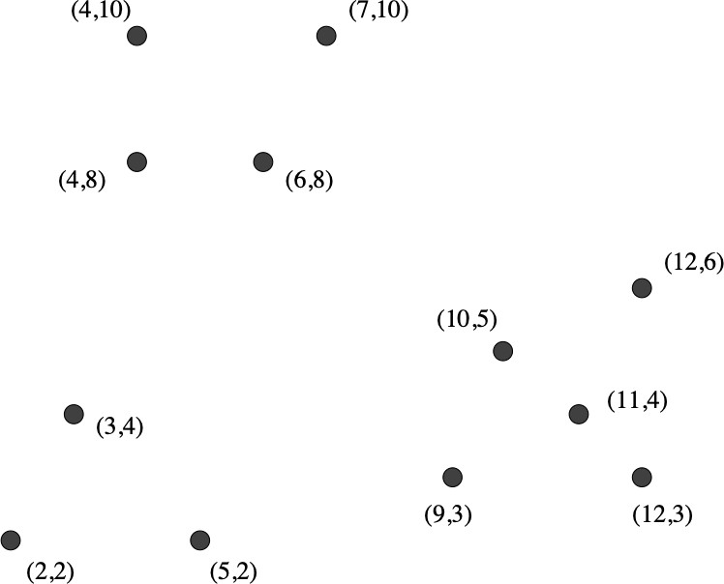
Initialization for k mean vectors µ_{i}: example
Initial selection for mean values [from Mining of Massive Datasets by J. Leskovec et al.]
data clustering

Slide 66

Initialization for k mean vectors µ_{i}: example (cont’d)
data clustering
Notes:
Điểm đầu tiên được chọn khác nhau thì khả năng các điểm sau cũng khác.

Slide 67
K–means is sensitive to outliers
The k–means algorithm is sensitive to outliers because such objects are far away from the majority of the data, and thus, when assigned to a cluster, they can dramatically distort the mean value of the cluster. This inadvertently affects the assignment of other objects to clusters. This effect is more serious due to the use of the squared error.
Example: consider 7 data points in the 1–d space: 1, 2, 3, 8, 9, 10, 25, with k = 2.
Intuitively, by visual inspection we may imagine the points partitioned into the clusters
{1, 2, 3} and {8, 9, 10}, where point 25 is excluded because it appears to be an outlier. How would k–means partition the values with k = 2?
Solution1: {1, 2, 3} with mean = 2 and {8, 9, 10, 25} with mean = 13. The error is:
(1 — 2)² + (2 — 2)² + (3 — 2)² + ·· · + (10 — 13)² + (25 — 13)² = 196
Solution2: {1, 2, 3, 8} with mean = 3.5 and {9, 10, 25} with mean = 14.67. The error is:
(1 — 3.5)² + (2 — 3.5)² + (3 — 3.5)² + (10 — 14.67)² + (25 — 14.67)² = 189.67.
The Solution2 is chosen because it has the lowest squared error. However, 8 should not be in cluster 1. In addition, the mean of the second cluster is 14.67 and quite far from 9 and 10 due to the outlier 25.
data clustering

Slide 68

K–medoids clustering algorithm
Rather using mean values, k–mediods pick actual data objects in the dataset to represent the clusters, using one representative object per cluster.
Each remaining object is assigned to the cluster of which the representative object is the most similar.
The partitioning method is then performed based on the principle of minimizing the sum of the dissimilarities between each object x and its corresponding representative object o_{i}. That is, an absolute–error criterion is used, defined as:
This is the basis for the k–medoids method, which groups n objects into k clusters by minimizing the absolute error.
When k = 1, we can find the exact median in O(n²) time. However, when k is a general positive number, the k–medoid problem is NP-hard.
data clustering

Slide 69
K–mediods: partitioning around mediods (PAM) algorithm
The partitioning around medoids (PAM) algorithm is a popular realization of
k–medoids clustering. It tackles the problem in an iterative, greedy way.
Like the k–means algorithm, the initial representative objects (called seeds) are chosen arbitrarily.
We consider whether replacing a representative object by a non–representative object would improve the clustering quality. All the possible replacements are tried out.
The iterative process of replacing representative objects by other objects continues until the quality of the resulting clustering cannot be improved by any replacement.
This quality is measured by a cost function of the sum of dissimilarity between every data object and the representative object of its cluster (equation 21).
data clustering

Slide 70
K–mediods: partitioning around mediods (PAM) algorithm (cont’d)
Specifically, let o₁, o₂,. .., o_{k} be the current set of representative objects (i.e., medoids) of the k clusters.
To determine whether a non–representative object, denoted by o_{random}, is a good replacement for a current medoid o_{j} (1 ≤ j ≤ k), we calculate the distance from every object x to the closest object in the set {o₁,. .., o_{j—1}, o_{random}, o_{j+1},. .., o_{k}}, and use the distance to update the cost function.
The reassignments of objects to {o₁,. .., o_{j—1}, o_{random}, o_{j+1},. .., o_{k}} are simple:
Suppose an object x is currently assigned to a cluster represented by mediod o_{j} : x
needs to be reassigned to either o_{random} or some other cluster represented by o_{i}
Suppose an object x is currently assigned to a cluster represented by some other o_{i}
(i /= j): x remains assigned to o_{i} as long as x is still closer to o_{i} than to o_{random}.
(i /= j), whichever is the closest.
Otherwise, x is reassigned to o_{random}.
If the error E (equation 21) decreases, replace o_{j} with o_{random}. Otherwise, o_{j} is acceptable and nothing is changed in the iteration. The algorithm will stop when there is no change in error E with all possible replacements.
data clustering
Notes:
Nhận xét: Việc xác định đối tượng đại diện mới cần nhiều tính toán hơn so với k-means.

Slide 71
Which method is more robust? k–means or k–medoids?
The k–medoids method is more robust than k–means in the presence of noise and outliers because a medoid is less influenced by outliers or other extreme values than a mean.
However, the complexity of each iteration in the k–medoids algorithm is O(k(nk)²).
For large values of n and k, such computation becomes very costly, and much more costly than the k–means method.
Both methods require the user to specify k, the number of clusters.
A typical k–medoids partitioning algorithm like PAM works effectively for small data sets, but does not scale well for large data sets. How can we scale up the
k–medoids method? To deal with larger data sets, a sampling–based method called
CLARA (Clustering LARge Applications) can be used.
data clustering
Notes:
Hỏi SV: Tại sao k-medoids lại được xem là robust hơn k-means? (theo nghĩa hoạt động tốt với dữ liệu nhiễu và có phần tử ngoại lai)

Slide 72

K–medians clustering algorithm
In the k–medians algorithm, the Manhattan distance (L₁ distance) is used in the objective function rather than the Euclidean (L₂ distance). The objective function in k–medians is:
(22)
where m_{i} is the median of the data points along each dimension in cluster C_{i}. This is because the point that has the minimum sum of L₁–distances to a set of points distributed on a line is the median of that set.
As the median is chosen independently along each dimension, the resulting
d–dimensional representative will (typically) not belong to the original dataset D. The k–medians approach is sometimes confused with the k–medoids approach, which chooses these representatives from the original database D.
The k–medians approach generally selects cluster representatives in a more robust way than k–means, because the median is not as sensitive to the presence of outliers in the cluster as the mean.
data clustering
Notes:
K-medians cũng đc coi là robust hơn k-means (outliers).
Về tính toán:
K-medoids: Tính toán phức tạp hơn vì phải chọn một điểm thực sự trong tập dữ liệu làm đại diện cho mỗi cụm, và cần đánh giá tất cả các điểm để tìm medoid.
K-medians: Tính toán trung vị đơn giản hơn (so với việc tìm medoid) vì trung vị chỉ là một giá trị thống kê của tập dữ liệu, không phải là điểm dữ liệu thực.

Slide 73
Outline
Data clustering concepts
Data understanding before clustering
Hierarchical clustering
Partitioning clustering
Distribution–based clustering
Density–based clustering
Clustering validation and evaluation
References and Summary
data clustering

Slide 74
References
J. Han, M. Kamber, and J. Pei. Data Mining: Concepts and Techniques. Morgan Kaufmann, Elsevier, 2012 [Book1].
C. Aggarwal. Data Mining: The Textbook. Springer, 2015 [Book2].
J. Leskovec, A. Rajaraman, and J. D. Ullman. Mining of Massive Datasets. Cambridge University Press, 2014 [Book3].
M. J. Zaki and W. M. Jr. Data Mining and Analysis: Fundamental Concepts and Algorithms. Cambridge University Press, 2013 [Book4].
D. Easley and J. Kleinberg. Networks, Crowds, and Markets: Reasoning About a Highly Connected World. Cambridge University Press, 2010 [Book5].
J. VanderPlas. Python Data Science Handbook: Essential Tools for Working with Data. O’Reilly, 2017 [Book6].
J. Grus. Data Science from Scratch: First Principles with Python. O’Reilly, 2015 [Book7].
data clustering

Slide 75
Summary
Introducing important concepts of clustering: definitions, types of clustering (hard vs. soft), main requirements for clustering, clustering approaches, challenges in clustering, and clustering applications.
Main techniques to understanding the data distribution before clustering: spatial histogram, cell–based entropy, distance distribution, and Hopkins statistic.
The hierarchical clustering approach with agglomerative method (bottom–up), dendrogram, different ways to merge clusters (single link, complete link, average link, centroid link, radius, and diameter).
The partitioning approach with k–means algorithm, the initialization of k centroids, and the variants of k–means including k–mediods (PAM algorithm) and k–medians.
data clustering

